Slide 1

SHORT-TERM ELECTRICAL LOAD FORECASTING FOR LEKHNATH FEEDER USING MACHINE AND DEEP LEARNING MODELS
Presenter,
Sujit Koirala
Department of Electrical Engineering
Masters Of Science In Power System Engineering
Institute Of Engineering Pulchowk Campus

Slide 2
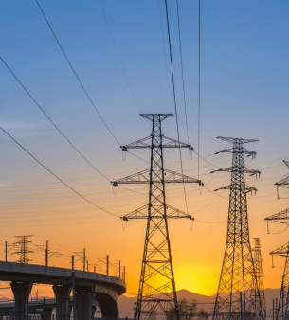
Introduction
Short-term electrical load forecasting is essential for planning and operating a reliable power system. It helps utilities manage demand, reduce costs, and improve overall efficiency. The Lekhnath Feeder serves a mix of households, businesses, and small industries, and its load pattern shifts with time, weather, and community activities. This project explores how modern machine learning and deep learning models can forecast its hourly demand more accurately than traditional methods.

Slide 3
Problem Statement
Existing forecasting methods for the Lekhnath Feeder rely on manual estimates or traditional statistical models that struggle to capture nonlinear and rapidly changing load patterns.
Weather changes, calendar effects, and local demand variations make the load behavior more complex, reducing the accuracy of current forecasting practices.
Inaccurate forecasts lead to poor generation scheduling, higher operational costs, increased technical losses, and potential reliability issues in the distribution system.
There is no systematic study that applies and compares advanced machine learning and deep learning models for short-term forecasting of this specific feeder.

Slide 4
Objectives
Build a Reliable Data Foundation
Collect and prepare historical load, weather, and calendar data for the Lekhnath Feeder. This ensures a complete and consistent dataset for developing accurate forecasting models.
Develop and Train Forecasting Models
Design and implement a set of machine learning and deep learning models, including SVR, Random Forest, XGBoost, LSTM, and GRU.
Evaluate and Identify the Best Forecasting Approach
Compare all models using standard performance metrics to determine which method delivers the most accurate and reliable short-term load forecasts

Slide 5
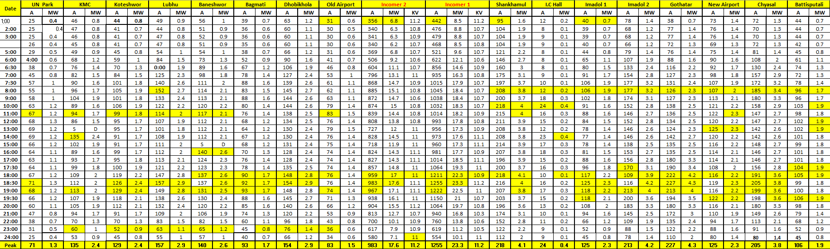
Methodology
Data Collection
Collect and prepare historical load, weather, and calendar data for the Lekhnath Feeder. This ensures a complete and consistent dataset for developing accurate forecasting models.

Slide 6
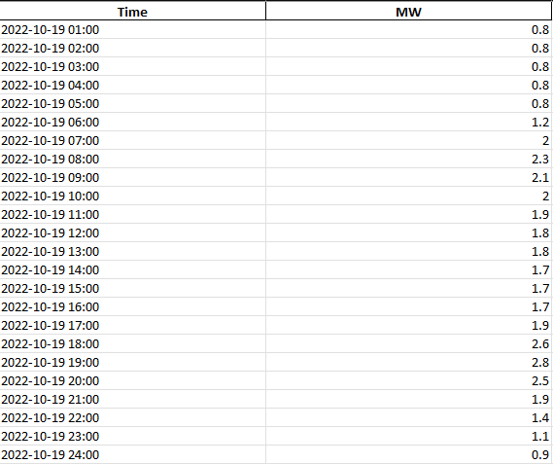
Methodology
Data Collection
Data Available from 2079-06-01 to 2082-06-30.
Different Excel Files for Each month with different sheets containing each day wise MW Usage of different location
Extracted the data of Lekhnath feeder from its column.
Combined all the months and year data into one file.

Slide 7
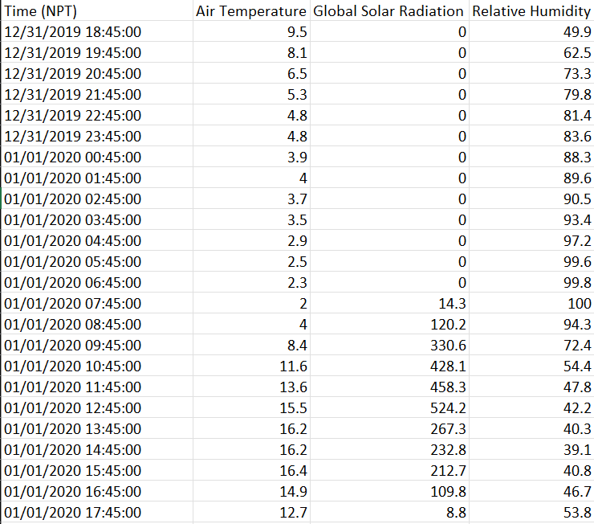
Methodology
Data Collection
Weather Data available for Khumaltar in one hour interval.
Extracted the data from 2079-06-01 to 2082-06-30
Prepared final data by related the data, time and hour between the weather data and feeder data.
Dataset Shape: 24528 rows x 5 columns

Slide 8
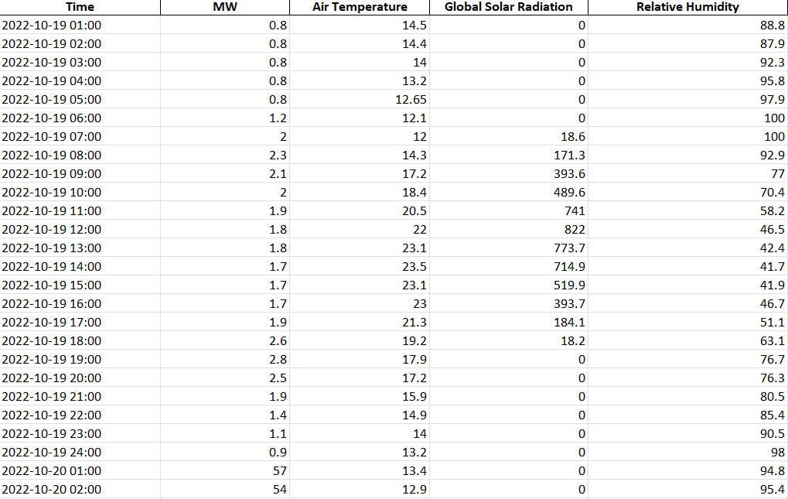
Methodology
Final Dataset

Slide 9
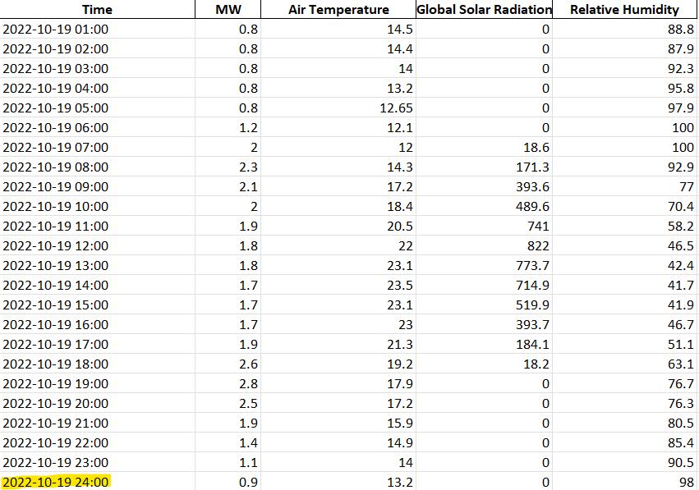
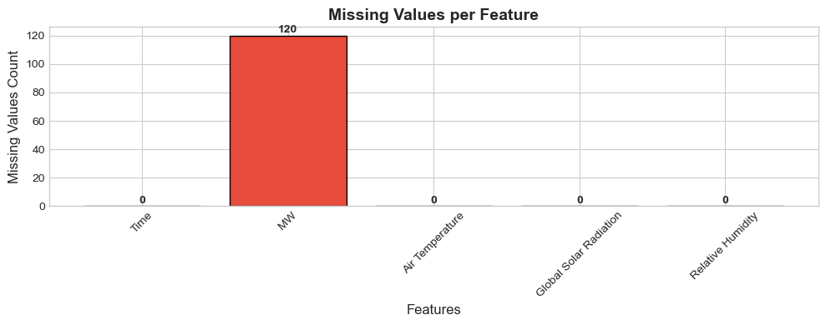
Methodology
Data Preprocessing
Two problems in Dataset
  120 Null Values in MW Column
  Date not formatted in 24 hrs format.
Solution
  Forward Backward Fill
  Converted 24:00 to 00:00

Slide 10
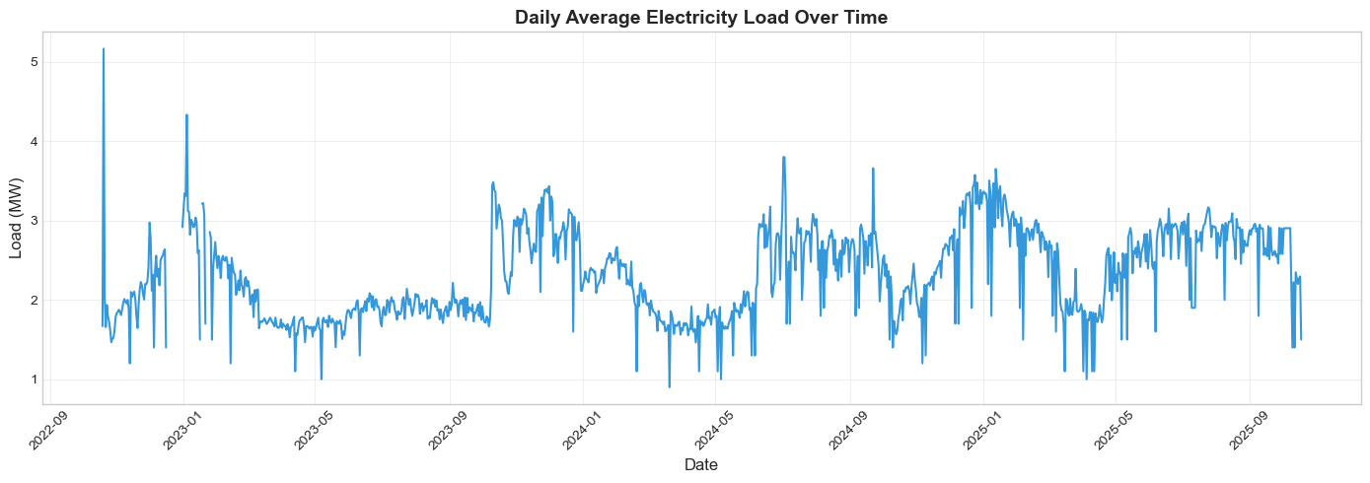
Methodology
Data Analysis

Slide 11
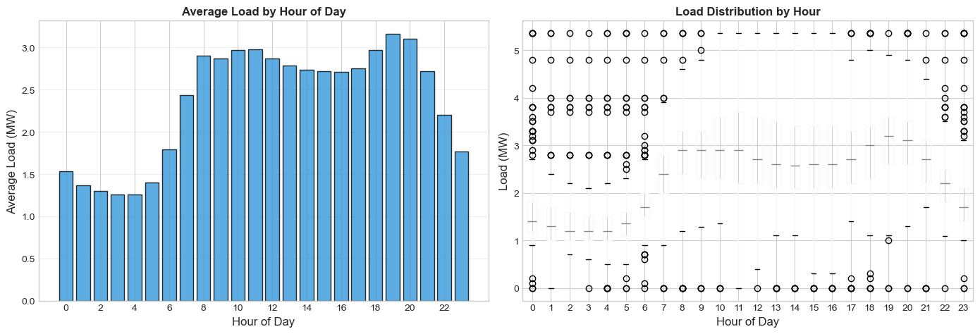
Methodology
Data Analysis

Slide 12
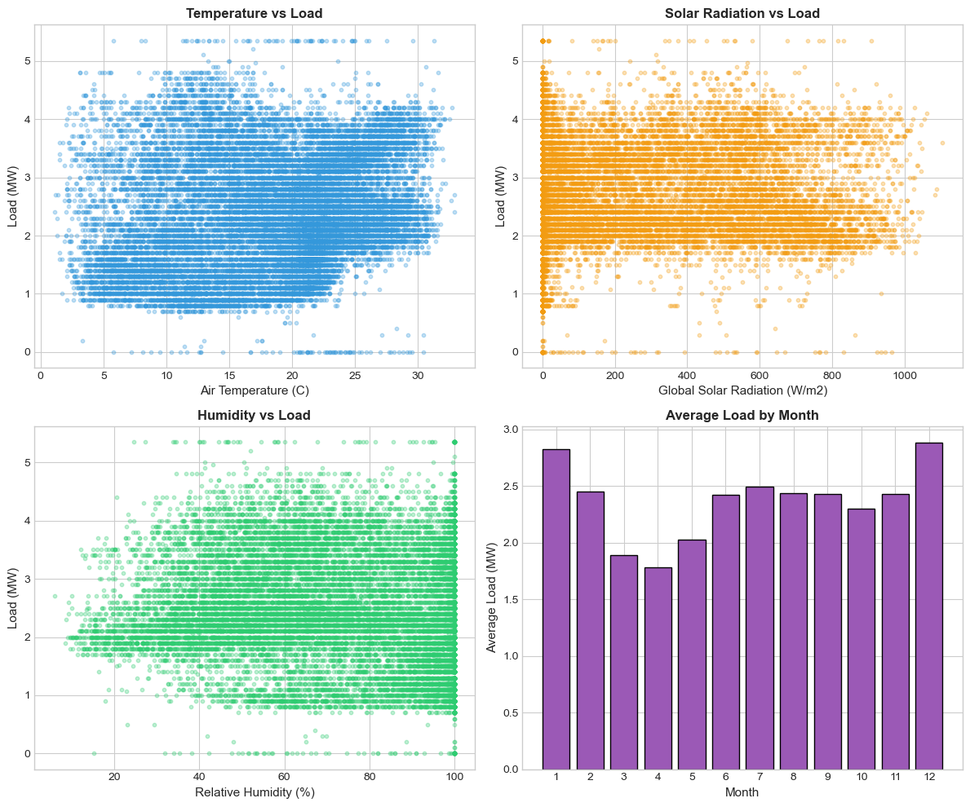
Methodology
Data Analysis

Slide 13
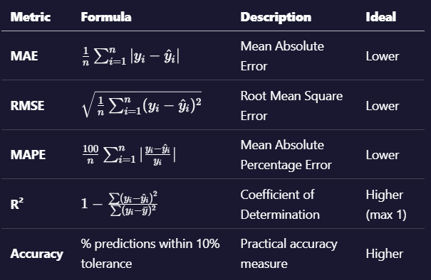
Methodology
Model Training
Trained Machine Learning Models
Linear Regression
Ridge Regression
Random Forest
Gradient Boosting
XG Boost
SVR
Evaluation Metrices

Slide 14
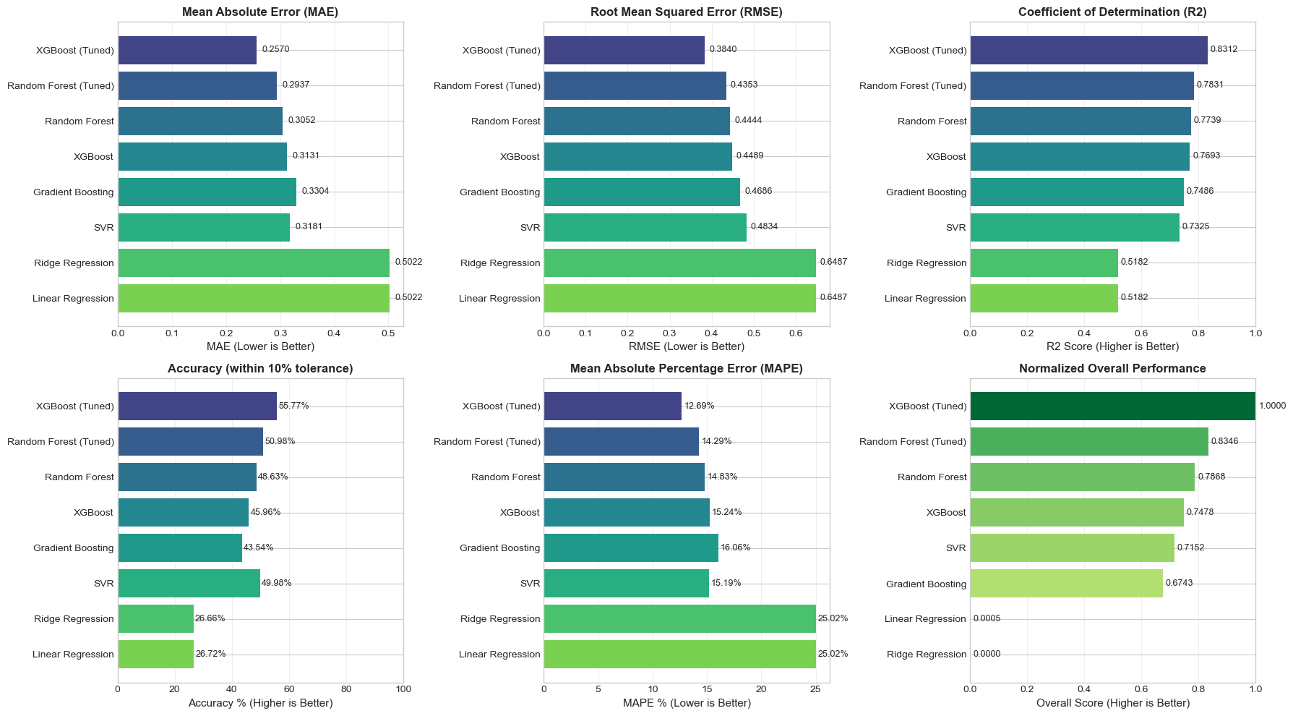
Model Results

Slide 15
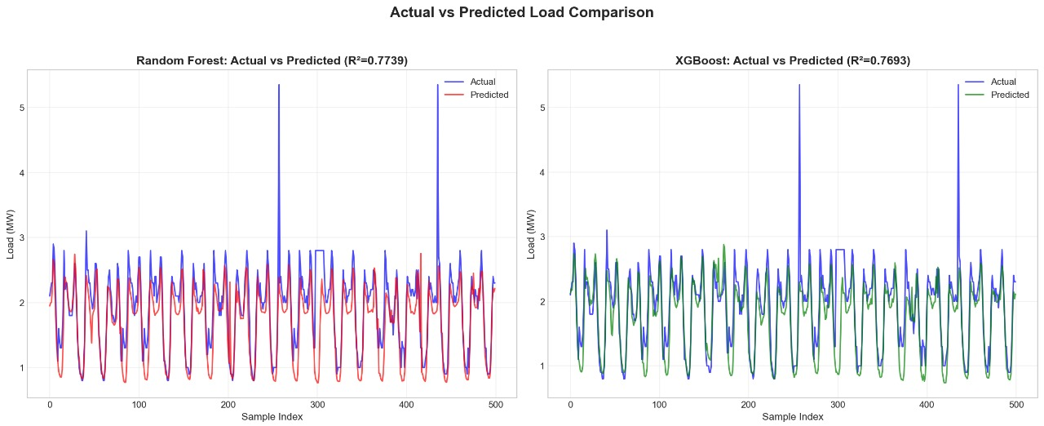
Model Results

Slide 16
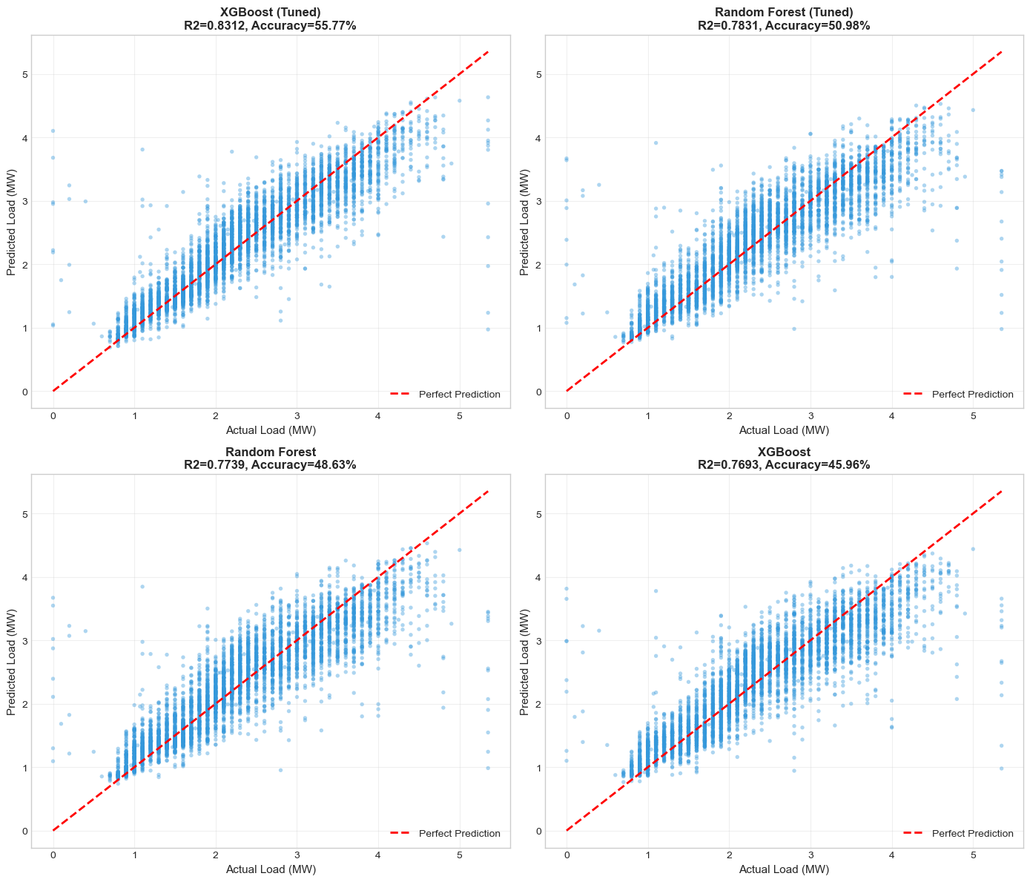
Model Results

Slide 17
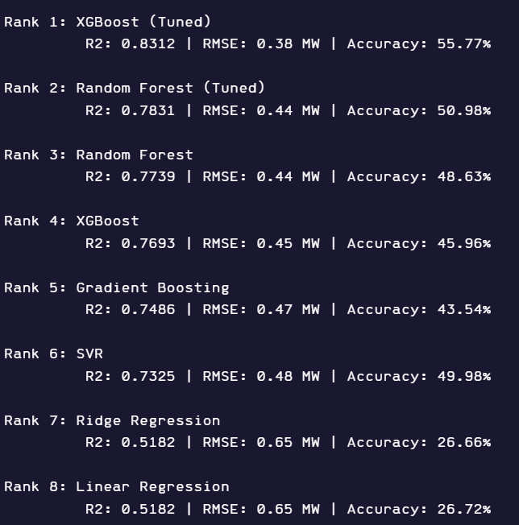
Model Results

Slide 18
Future Plan
Training Deep Learning Model
Training of the DL Models,
LSTM
GRU
Fine tune to them.
Identifying the Best Models
Identifying the best Model out of all. Create a interface to input data and predict the MW Load.

Slide 19
Thanks!
Do you have any questions?
SHORT-TERM ELECTRICAL LOAD FORECASTING FOR LEKHNATH FEEDER USING MACHINE AND DEEP LEARNING MODELS
Presenter,
Sujit Koirala
Department of Electrical Engineering
Masters Of Science In Power System Engineering
Institute Of Engineering Pulchowk Campus

